Slide 1


SMART INDIA HACKATHON 2024
TITLE PAGE
Problem Statement ID – 1681
Problem Statement Title-Identification of algorithm from the given dataset using AI/ML
Techniques.
Theme-Blockchain & Cybersecurity
PS Category- Software
Team ID- 0000
Team Name – Team Ayurastra

Slide 2

SmartCrypto:AI-Powered Cryptographic Algorithm Identifier
Proposed Solution
An AI/ML-based software solution that automatically identifies cryptographic algorithms from encrypted data by analyzing unique patterns.
Data Collection & Feature Extraction: Encrypted data is analyzed for distinctive patterns, like block size and key length.
AI/ML Model Training: A machine learning model is trained to classify different cryptographic algorithms based on extracted features.
Prediction & Automation: The software takes encrypted data as input and outputs the probable cryptographic algorithm automatically.
Technology Stack: Uses Python, TensorFlow/Scikit-learn, and cryptographic libraries for pattern recognition and algorithm prediction.
Unique Value Proposition
AI-Based Algorithm Detection: Utilizes machine learning to automatically identify cryptographic algorithms, eliminating the need for manual analysis. This ensures faster and more accurate detection compared to traditional methods.
Real-Time Data Analysis: Provides instant results from encrypted data with minimal user input, making it user-friendly and efficient. The system can handle large datasets and deliver quick predictions.
Scalable and Future-Ready: The solution is designed to easily integrate new cryptographic algorithms as they emerge. This ensures long-term adaptability and keeps the system relevant in a rapidly evolving security landscape.

Slide 3
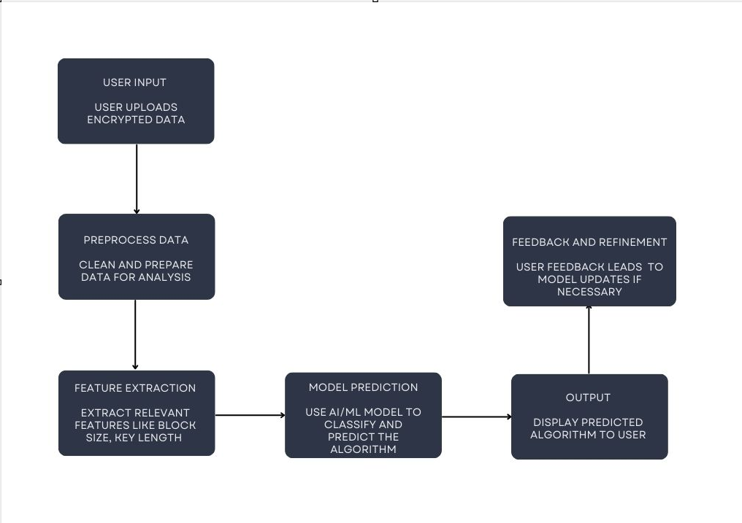
TECHNICAL APPROACH
Process Flow Architecture
Technology Stack
Programming Language: Python
Machine Learning Libraries: TensorFlow, Scikit-learn
Data Processing: Pandas, NumPy
Cryptographic Libraries: PyCryptodome
Model Training and Testing: Jupyter Notebook, Google Colab
Software Development: Flask or Django (for building the web interface)

Slide 4
FEASIBILITY AND VIABILITY
Challenges And Risks
Feasibility Of The Idea
Data Integrity: Ensuring the dataset is comprehensive and representative of various cryptographic algorithms to avoid biases and inaccuracies in predictions.
Model Performance: Achieving and maintaining high accuracy of the AI/ML model, which may require extensive tuning and validation, especially for complex algorithms.
Technological Readiness: AI/ML tools and libraries (e.g., TensorFlow, Scikit-learn) are well-established and can be used to implement the solution effectively.
Data Availability: Access to datasets for various cryptographic algorithms is feasible, either through public sources or by generating synthetic data.
Scalability: The solution can be scaled to handle new cryptographic algorithms and larger datasets, making it adaptable to future developments.
Cost and Resources: Utilizing open-source tools and cloud-based services for model training and deployment helps in keeping costs manageable and resources efficient.
Mitigation strategies
Data Quality Assurance: Regularly validate and update the dataset,using a mix of real and synthetic data to cover various cryptographic algorithms.
Model Optimization: Implement rigorous testing and tuning processes to enhance model
Resource Management: Utilize efficient computing resources, such as cloud-based services with scalable options

Slide 5
IMPACT AND BENEFITS
Your Team Name
v
Potential Impact
Enhanced Security: Improving the ability to identify cryptographic algorithms can strengthen security protocols by allowing for better detection and analysis of potential vulnerabilities.
Increased Efficiency: Automating the identification of cryptographic algorithms streamlines the process, saving time and resources compared to manual analysis.
Innovation in Cryptography: Providing insights into algorithm identification can drive advancements in cryptographic research and development, fostering innovation in secure communication technologies.
Key Benefits
Accurate Algorithm Detection: Enables precise identification of cryptographic algorithms, enhancing security measures and reducing the risk of exploitation.
Time and Cost Efficiency: Automates the algorithm identification process, saving time and reducing costs compared to manual methods.
Scalability and Adaptability: Easily scalable to accommodate new algorithms and adaptable to evolving cryptographic standards, ensuring long-term relevance and effectiveness.
Enhanced Security: Improving the ability to identify cryptographic algorithms can strengthen security protocols by allowing for better detection and analysis of potential vulnerabilities.
Increased Efficiency: Automating the identification of cryptographic algorithms streamlines the process, saving time and resources compared to manual analysis.
Innovation in Cryptography: Providing insights into algorithm identification can drive advancements in cryptographic research and development, fostering innovation in secure communication technologies.

Slide 6
RESEARCH AND REFERENCES
Your Team Name
https://nvlpubs.nist.gov/nistpubs/FIPS/NIST.FIPS.197.pdf
https://www.youtube.com/watch?v=O4xNJsjtN6E
https://youtu.be/JxcBm7CRtI0?si=JiKsUt1E1ABSK-mE
https://youtu.be/3MPkc-PFSRI?si=QQJpcOztCjh9bcUJ
https://www.ijert.org/research/comparative-study-of-cryptographic-algorithms-IJERTV9IS110240.pdf
https://www.rambus.com/blogs/side-channel-attacks-target-machine-learning-ml-models/

